Slide 1
Control Flow
The translation of statements such as if-else-statements and while-statements is tied to the translation of boolean expressions. In programming languages, boolean expressions are often used to
1. Alter the flow of control. Boolean expressions are used as conditional expressions in statements that alter the flow of control. The value of such boolean expressions is implicit in a position reached in a program.
2.Compute logical values. A boolean expression can represent true or false as values. Such boolean expressions can be evaluated in analogy to arithmetic expressions using three-address instructions with logical operators.
Boolean expressions are composed of the boolean operators (which we denote &&, ||, and !), using the C convention for the operators AND, OR, and NOT respectively.
B->B || B | B && B | !B | (B) | E rel E | true |false
rel-> < |<= |> |>= |!= |=

Slide 2
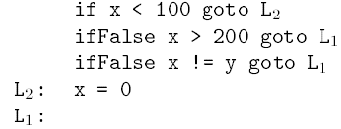
Short-Circuit Code
In short-circuit (or jumping) code, the boolean operators &&, ||, and ! translate into jumps. The operators themselves do not appear in the code; instead, the value of a boolean expression is represented by a position in the code sequence.
The statement
can be translated into
Jumping Code

Slide 3
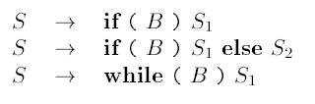
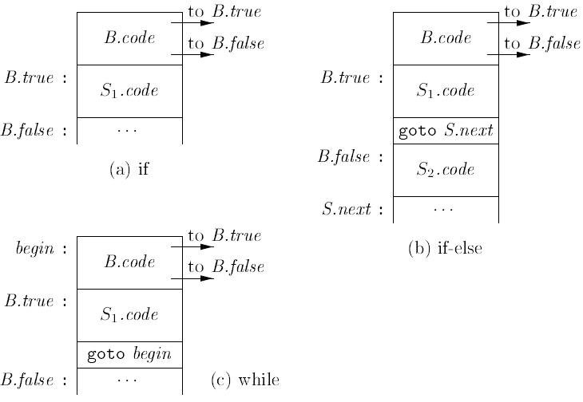
Flow of Control Statements

Slide 4
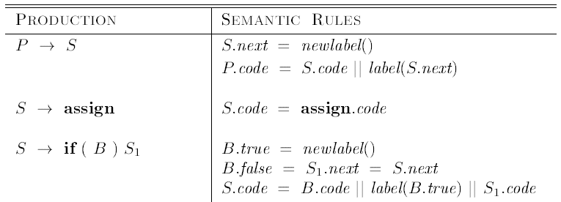
Syntax Directed Definition for flow of control statements
next, true, false-inherited attributes
code- synthesized attribute

Slide 5
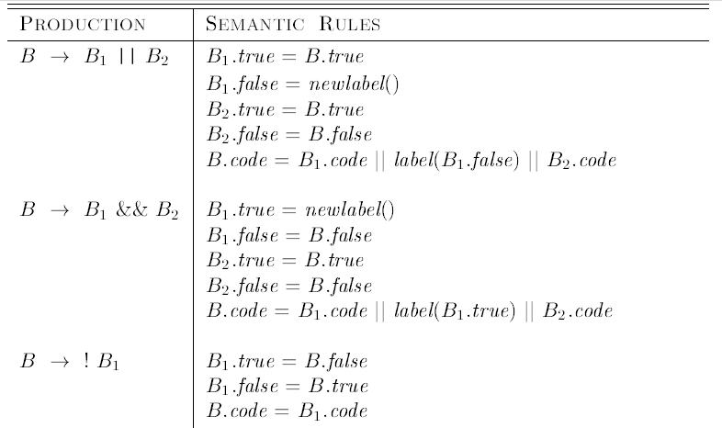
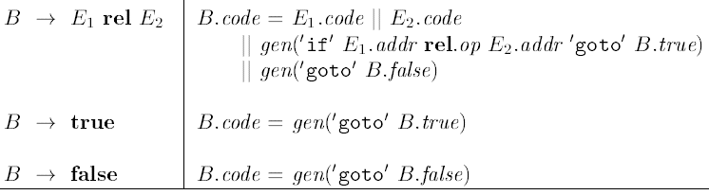
Control-Flow Translation of Boolean Expressions

Slide 6
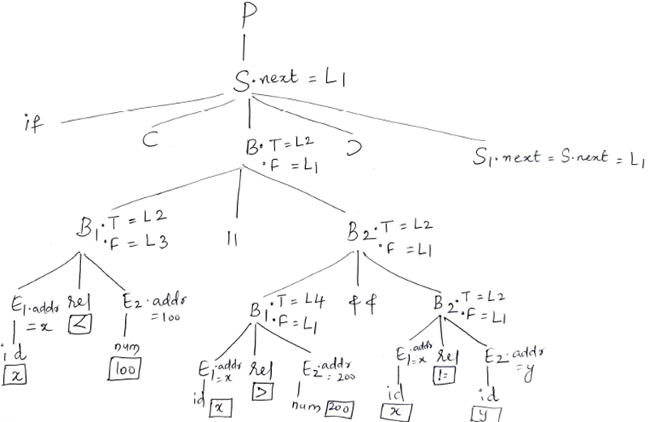
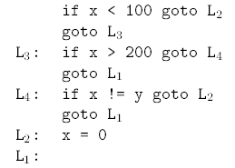
Control-Flow Translation of a simple-if statement
Three Address Code

Slide 7
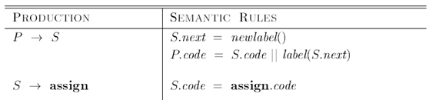

Syntax Directed Definition for flow of control statements

Slide 8
